Slide 1

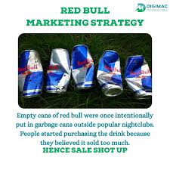
Red Bull Digital Marketing
Red Bull is a global energy drink company known for its extreme sports marketing and unique brand image. The company has a strong digital presence, leveraging various platforms to connect with its target audience and build brand loyalty.
This presentation outlines Red Bull's digital marketing strategy, covering objectives, target audience, preferred channels, and specific strategies to achieve growth and brand awareness.

Slide 2

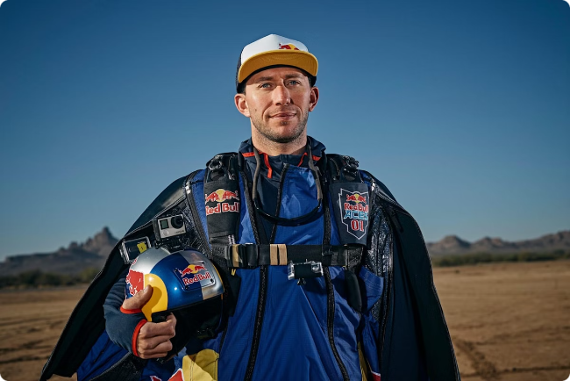
Red Bull's Digital Ecosystem
Website
Social Media
Red Bull's website serves as a central hub for news, events, athlete profiles, and brand content.
Red Bull maintains a strong presence across major social media platforms, including YouTube, Facebook, Instagram, and Twitter.
Mobile Apps
Digital Platforms
Red Bull offers mobile apps for live event coverage, athlete tracking, and exclusive content access.
Red Bull has established various digital platforms dedicated to specific sports and activities, such as Red Bull TV and Red Bull Media House.

Slide 3

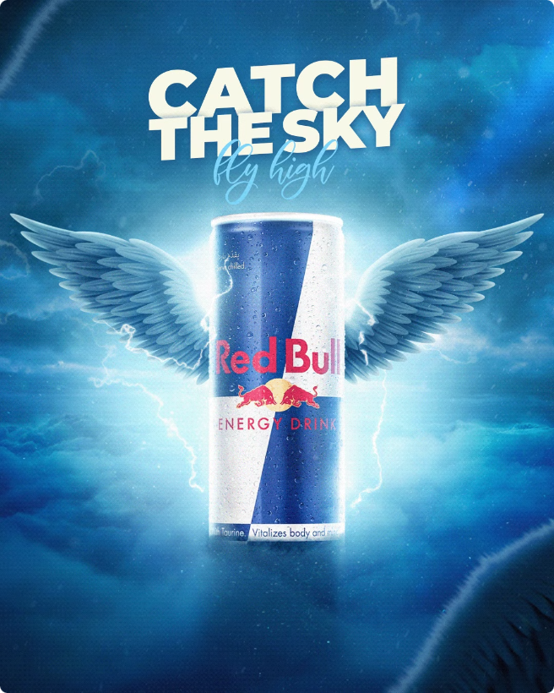




Social Media Strategies
Community Building
Red Bull actively engages with its audience on social media, fostering a sense of community and shared passion.
Live Streaming
Red Bull uses live streaming to bring events and athlete experiences directly to its audience.
Social Media Contests
Red Bull utilizes social media contests to promote brand awareness, engage fans, and create buzz.
Influencer Marketing
Red Bull collaborates with influential athletes and content creators to amplify its message and reach a wider audience.

Slide 4
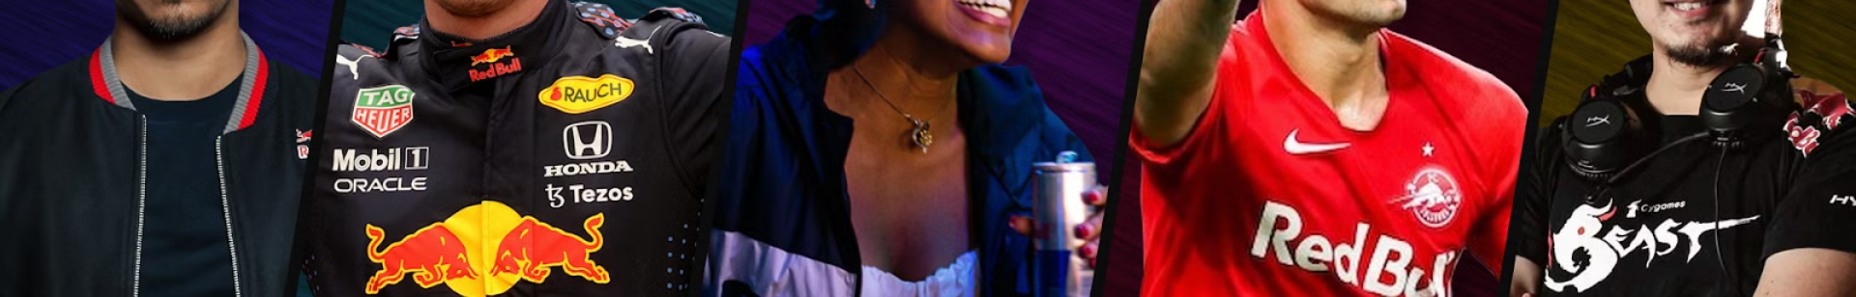
Influencer Marketing Campaigns
Athlete Collaborations
Partnerships with high-profile athletes in various sports to endorse Red Bull and promote its values.
Content Co-Creation
Working with influencers to develop custom content that resonates with their audience and promotes Red Bull's brand.
Targeted Reach
Leveraging influencer networks to reach specific demographics and interests, effectively targeting Red Bull's target audience.
Authenticity and Credibility
Influencer marketing provides a sense of authenticity and credibility, as fans trust recommendations from individuals they follow.

Slide 5

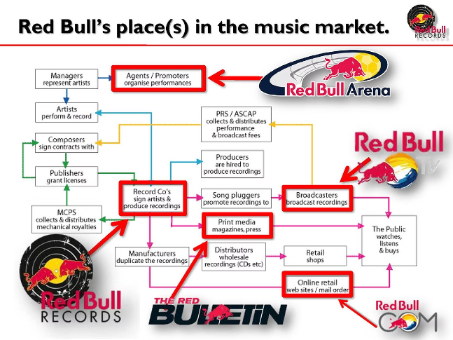
Objectives of Red Bull Digital Marketing
1
Brand Awareness
2
Audience Engagement
Red Bull aims to increase brand awareness and recognition among its target audience.
Red Bull seeks to build a strong and engaged online community, fostering a sense of loyalty and interaction.
3
Sales and Revenue Generation
4
Content Distribution
Red Bull's objective is to distribute its content effectively across various digital channels to reach a wider audience.
Red Bull utilizes its digital platforms to promote its products and drive sales.

